Slide 1
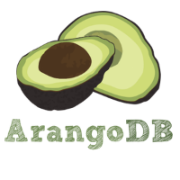
ArangoDB
Multi-Model NO-sql DAtabase
Presented BY:- Prakhya Tejaswi
Sapna Patil
ShravAni GADDAM
Waseem AZHAR

Slide 2
Outline
Database (Document,Key-value,Graph)
Polyglot persistence?
Why ArangoDB started ?
About ArangoDB
Multi model database
Main Features
AQL(ACID,Joins)
What is Graph database ?
Why are graph database good for storing

Slide 3
Outline
SQL / AQL – Comparison
AQL
Queries
Languages
Explain Graphs by Aranogosh and Graphical interface
Drivers
Clustering
Replication and Sharding

Slide 4
Document store
Document stores the set of documents which means JSON data
Set are called collections
Database has access to contents of set
Schema-less
Versatile
Notes:
Normally based on key-value stores (each document still has a unique key)
Allow to save documents with logical similarity in „collections“
Treat data records as attribute-structured documents (data is no longer opaque)
Often allows querying and indexing document attributes
For efficient memory handling we have an automatic schema recognition.
It has different ways to retrieve data. CRUD via RESTful Interface, QueryByExample, JS for graph traversals and AQL

Slide 5
Key –Value Store
Map value data to unique string keys (identifiers)
Treat data as opaque (data has no structure)
Key lookup without secondary indexes
High Performance and Perfect scalability
More restricted queries - better scalability

Slide 6
Graph Database
Graph database stores labelled graph
Vertices and edges can be document
Graph are good model for relations
Graph queries like traversal are crucial.

Slide 7
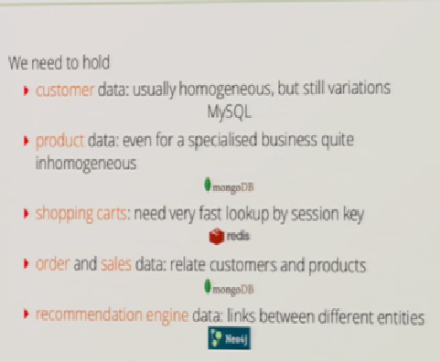
Polyglot Persistence—Online shop
IDEA
Use Right data model for each part of the System

Slide 8
Polyglot Persistence is nice but…
Disadvantage:-
One project need multiple database
So, to have Benefits without Disadvanges Multimodel ArangoDB comes into play.

Slide 9
Why ArangoDB started ?
Second Generation NoSQL DB
Unique feature set
Solves some problems of other NoSQL DBs
Greenfield project
Experienced team building NoSQL DBs for more than 10 years
Notes:
It is not a derivative from an internal solution of a company like most of the other NoSQL solutions. It's build with the idea of multi-model, extensibility and scalability from the first line of code.

Slide 10
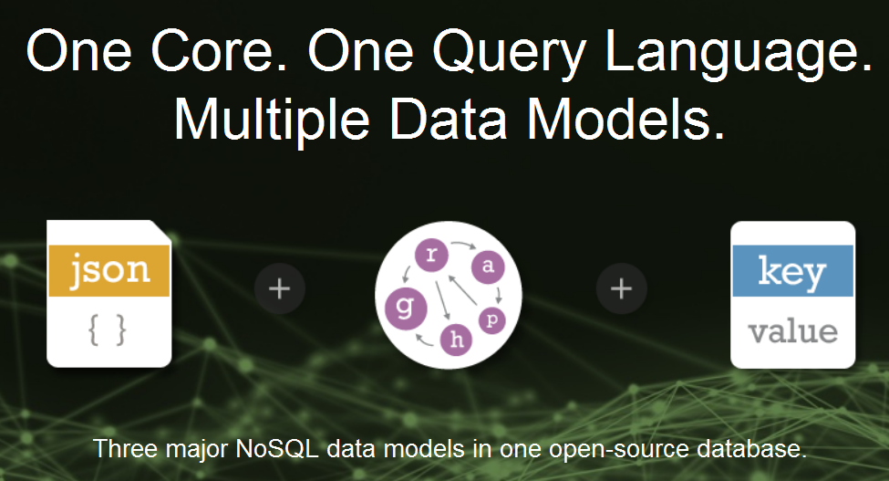
DOCUMENT STORE + GRAPH STORE + KEY-VALUE STORE
MULTIMODEL DATABASE
Common query Language with All Three data models
Allows polyglot persistence with single Database
Notes:
polyglot persistence is the idea that you may have many different persistent stores for different areas of your application

Slide 11
About ArangoDB
AvocadoDB” becomes “ArangoDB - May 2012
Multimodel database –NoSQL Database
Created by : Claudius Weinberger, Frank Celler, Jan Steemann
Year: 2011
Language : JS,C++
License :Available under Apache 2

Slide 12
Key-Value And Document Store for ArangoDB
It‘s currently supported as a key-value document.
In the near future it supports special key-value collection.
One of the optimization will be the elimination of JSON in this case, so the value need not be parsed.
Sharding capabilities of Key-Value Collections will differ from Document Collections
It supports both.
A database can contain collections from different types.
For efficient memory handling they have an automatic schema recognition.
It has different ways to retrieve data.

Slide 13
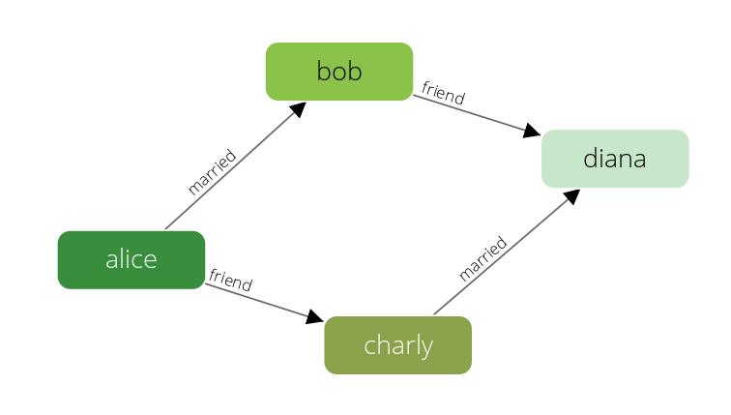
What is Graph Database ?
Graph structures for queries with nodes(vertices), edges and properties to represent and store data.
Edge or relationship or physical pointer, which directly relates data items in the store.
Dealing with data that has lots of relations stays manageable
Retrieving data from a graph database requires query language.

Slide 14
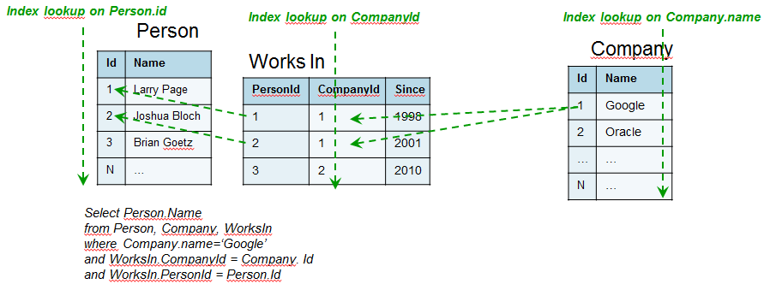
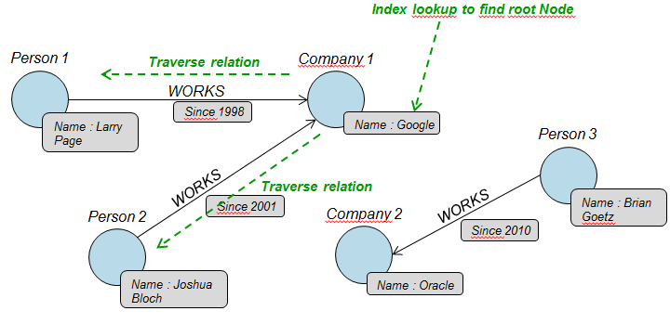
A graph database is any storage solution where connected elements are linked together without using an index

Slide 15
Why graph DB is good for storing?
Next generation of relational database
High support for “relationships”.
Eliminating search computation and provides faster processing.
Managing large chunks of data
Availability
Massive write performance.

Slide 16
AQL / SQL comparision
AQL is similar to the SQL but the syntax of AQL queries is different to SQL.
Supports reading and modifying collection data.
AQL doesn’t support creating and dropping collections.
Where SQL has a pre-defined sequence, AQL is executed left-ro-right.

Slide 18
Main Features
Free and open source
Apache 2 License,
Convenient querying via HTTP/REST and AQL
Include joins between different collections
Configurable consistencies guarantees using transactions
Memory efficient by shape detection
Extendable through JS
High Performance and Space efficiency
Graphical user Interface

Slide 19
It uses JavaScript thought (google’sv8 built in to server)
API is extendable using JavaScript code
Offers many drivers for languages
Its easy to use the Web front and Documentation
Professional Support

Slide 20
Language C++,JavaScript
running user-defined JavaScript code in the database
ArangoDB’s Foxx framework can be used to make any database functionality available via an HTTP REST API.
arangosh, the ArangoShell, and arangod, the database server, are written in C++
C++ for effective control of memory usage and parallelism
AQL’s query parser is written using the usual combination of Flex and Bison
The AQL optimizer, AQL executor and many AQL functions uses JavaScript

Slide 21
AQL
The ArangoDB query language (AQL)
Why not another query language ? (SQL,UNQL,XQUERY JSONiq)
Implemented in C and JavaScript
used to retrieve and modify data that are stored in ArangoDB.
A client application ships an AQL query to the ArangoDB server.
ArangoDB will parse the query, execute it and compile the results
. If the query is invalid or cannot be executed, the server will return an error that the client can process and react to it
AQL aims to be human-readable and therefore uses keywords from the English language
Another design goal of AQL was client independency
Notes:
The ArangoDB query language (AQL) can be used to retrieve and modify data that are stored in ArangoDB.
A client application ships an AQL query to the ArangoDB server. The query text contains everything ArangoDB needs to compile the result set
ArangoDB will parse the query, execute it and compile the results. If the query is invalid or cannot be executed, the server will return an error that the client can process and react to. If the query can be executed successfully, the server will return the query results (if any) to the client
Another design goal of AQL was client independency, meaning that the language and syntax are the same for all clients, no matter what programming language the clients may use.

Slide 22
How to invoke AQL
AQL supports reading and modifying collection data
It is a pure data manipulation language
AQL queries can be executed using:
the web interface,
the db object (either in arangosh or in a Foxx service)
or the raw HTTP API.
Notes:
AQL supports reading and modifying collection data, but it doesn't support data-definition operations such as creating and dropping databases, collections and indexes. It is a pure data manipulation language (DML), not a data definition language (DDL) or a data control language (DCL).
How to invoke AQL
AQL queries can be executed using:
the web interface,
the db object (either in arangosh or in a Foxx service)
or the raw HTTP API.
There are always calls to the server's API under the hood, but the web interface and the db object abstract away the low-level communication details and are thus easier to use.
The ArangoDB Web Interface has a specific tab for AQL queries execution.
You can run AQL queries from the ArangoDB Shell with the _query and _createStatement methods of the db object. This chapter also describes how to use bind parameters, statistics, counting and cursors with arangosh.
If you are using Foxx, see how to write database queries for examples including tagged template strings.
If you want to run AQL queries from your application via the HTTP REST API, see the full API description at HTTP Interface for AQL Query Cursors.

Slide 23
AQL supports the following data-modification operations:
INSERT: insert new documents into a collection
UPDATE: partially update existing documents in a collection
REPLACE: completely replace existing documents in a collection
REMOVE: remove existing documents from a collection
UPSERT: conditionally insert or update documents in a collection

Slide 24
AQL Graph Operations
AQL Traversals
AQL Shortest Path
JavaScript General Graph implementation, as you may use it in Foxx Services
Graph Management;
Graph Functions
Manipulating collections of named graphs with regular document functions
Notes:
AQL Traversals on both named and anonymous graphs
AQL Shortest Path on both named and anonymous grap
Manipulating collections of named graphs with regular document functions
The underlying collections of the named graphs are still accessible using the standard methods for collections. However the graph module adds an additional layer on top of these collections giving you the following guarantees:
All modifications are executed transactional
If you delete a vertex all edges will be deleted, you will never have loose ends
If you insert an edge it is checked if the edge matches the edge definitions, your edge collections will only contain valid edges
These guarantees are lost if you access the collections in any other way than the graph module or AQL, so if you delete documents from your vertex collections directly, the edges pointing to them will be remain in place

Slide 25
Convenient querying
Query a document by its unique id / key:
GET /_api/document/users/12345
Query by providing an example document:
PUT /_api/simple/by-example
{"name": "Jan", "age": 38 }
Query via SQL
FOR user IN users
FILTER user.active == true
RETURN {name: user.name }

Slide 26
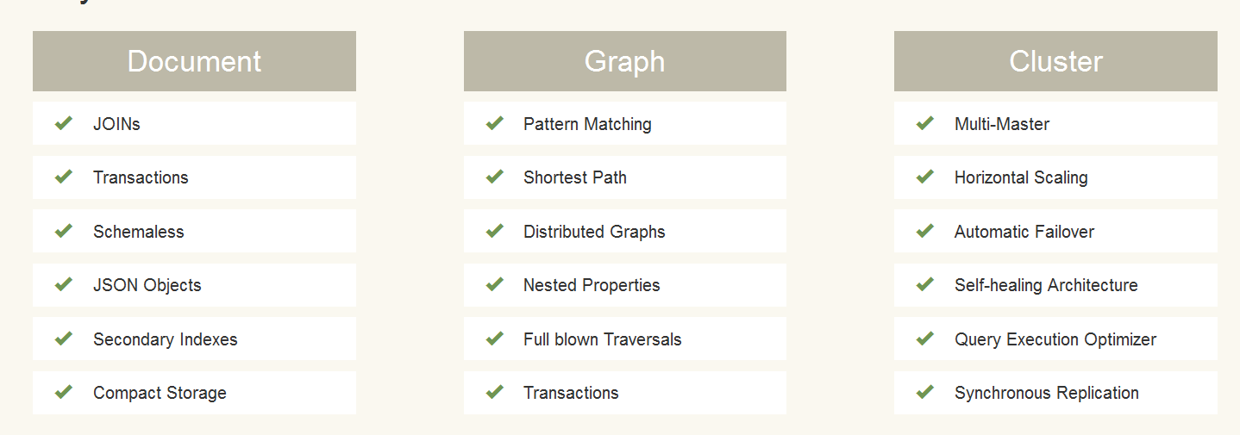
Key Feature in Nutshell

Slide 27
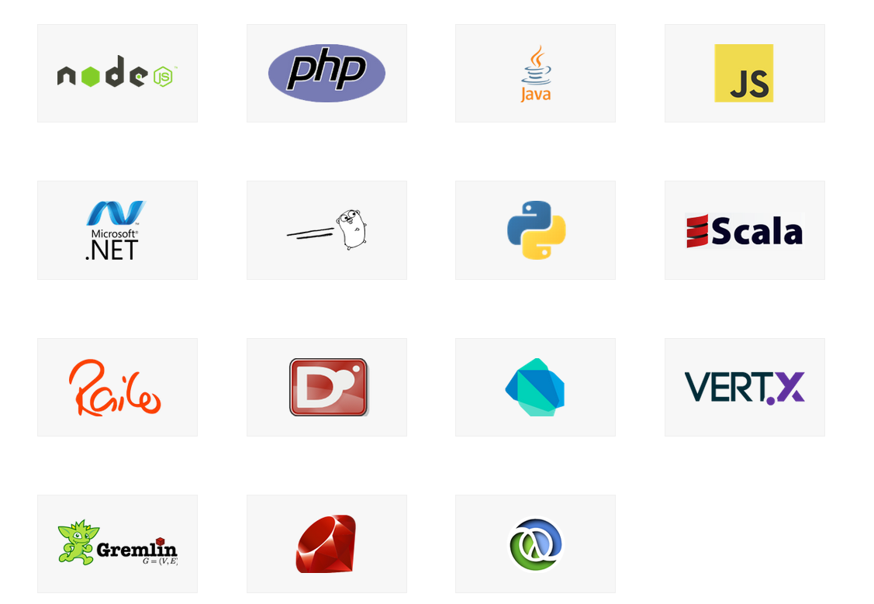
latest driver for language of ARANGODB

Slide 28
DEMO OF ARANGODB

Slide 29
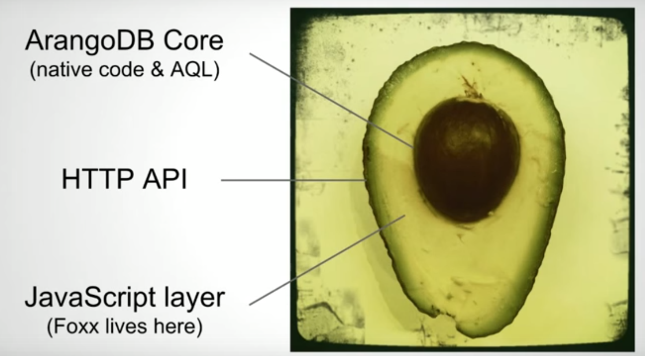
ArangoDB is a database that serves documents to clients.
These documents are transported using JSON via a TCP connection, using the HTTP protocol.
A REST API is provided to interact with the database system.

Slide 30
FOXX Microservices
ArangoDB allows application developers to write their data access and domain logic as microservices running directly within the database .
The Foxx microservice framework makes it easy to extend ArangoDB's own REST API with custom HTTP endpoints
Foxx is an easy way to create APIs and simple web applications from within ArangoDB.

Slide 31
FOXX Microservices
BENEFITS:
Reduced network overhead
Sensitive information never has to leave the database
Automatic generated Swagger documentation
Infinitely extensible
Created few FOXX services below:http://67.205.143.154:8529/_db/_system/_admin/aardvark/standalone.html#

Slide 32
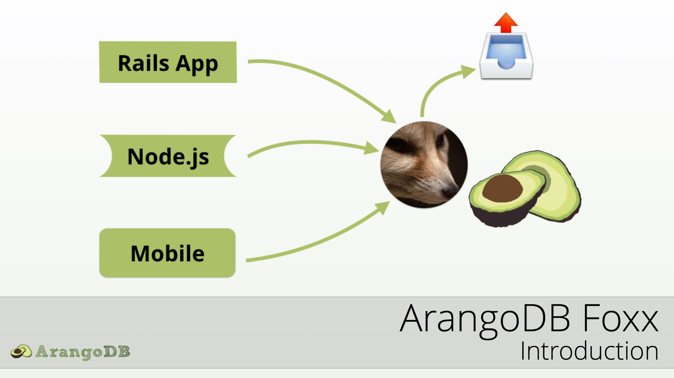
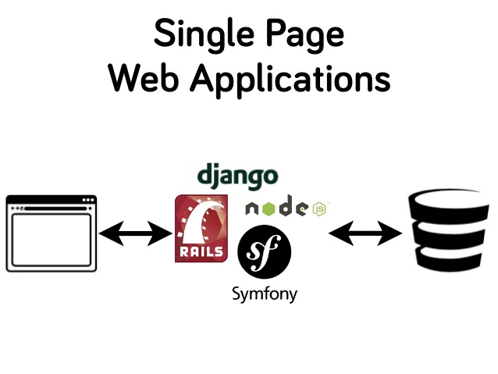
FOXX Micro Services

Slide 33
Scalability
ArangoDB is scaled horizontally.
many servers .
performance and capacity improvements, resilience - replication and automatic fail-over.
ArangoDB has no built-in limitations to horizontal scalability.
One can also scale ArangoDB vertically,
Larger servers.
Disadvantage - costs grow faster than linear with the size of the server.
No resilience and dynamical capabilities .

Slide 34
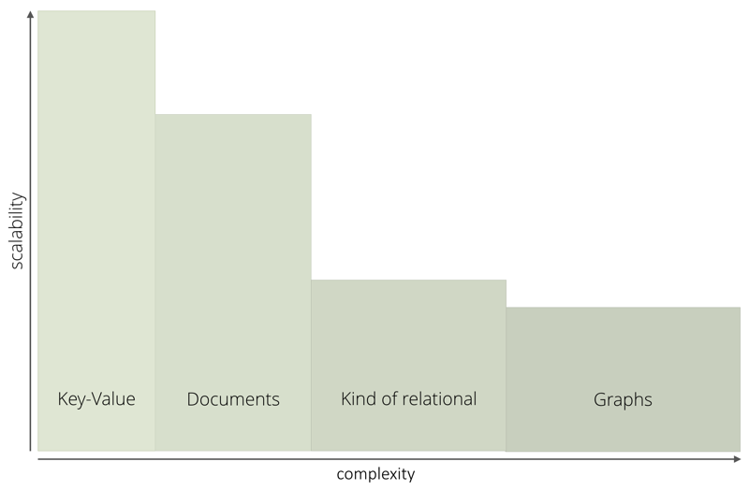
Scalability
The possibility to scale decreases from key/value over documents (documents with joins) to graphs.

Slide 35
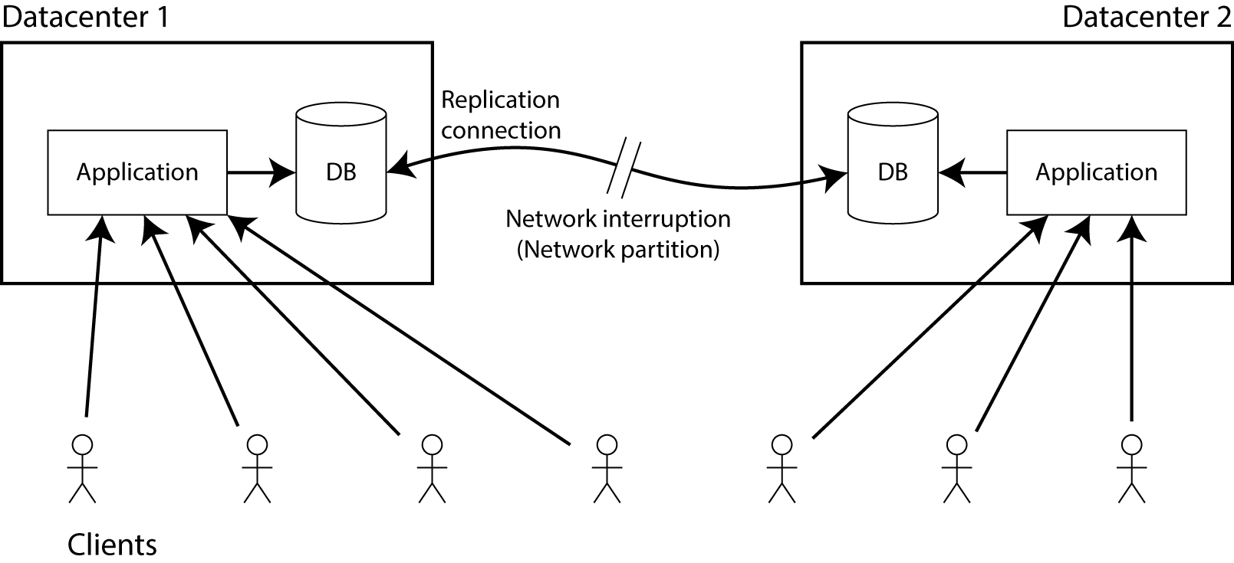
Cluster Architecture
The cluster architecture of ArangoDB is a CP master/master model .
With “CP” we mean that in the presence of a network partition, the database prefers internal consistency over availability
With “master/master” we mean that clients can send their requests to an arbitrary node, and experience the same view on the database regardless.

Slide 36
Clustering
An ArangoDB cluster consists of a number of ArangoDB instances which talk to each other over the network.
The current configuration of the cluster is held in the “Agency”
For the various instances in an ArangoDB cluster there are 4 distinct roles:
Agents,
Coordinators,
Primary and
Secondary DBservers.

Slide 37
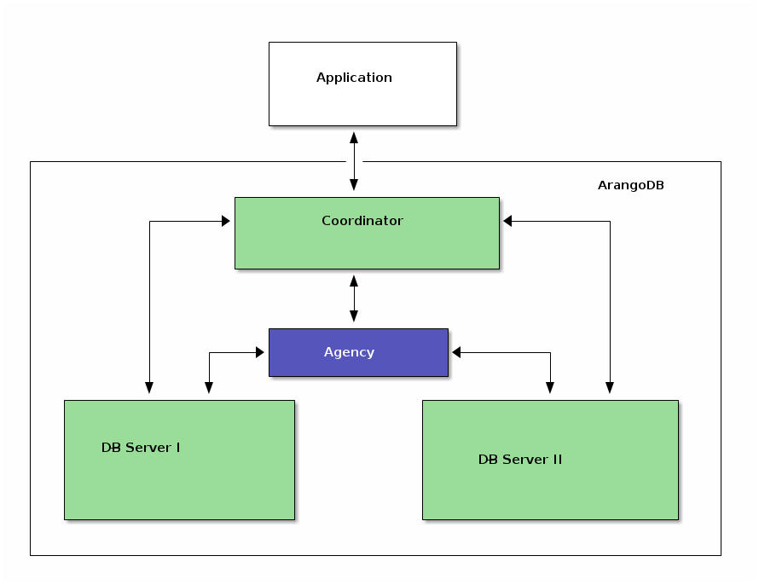
Structure of a cluster

Slide 38
Agents
One or multiple Agents - ArangoDB cluster.
central place to store the configuration in a cluster.
synchronization services cluster.
Heart of the cluster.
Coordinators
Coordinators are the ones the clients talk to.
cluster tasks - executing queries and running Foxx services.
They know where the data is stored and will optimize where to run user supplied queries or parts thereof.
stateless, shut down and restarted as needed.

Slide 39
Primary DBservers
The data is actually hosted.
They host shards of data
Synchronous replication a primary may either be leader or follower for a shard.
Execute queries in part/whole when asked by a coordinator.
Secondaries
Secondary DBservers are asynchronous replicas of primaries.
Synchronous replication, don’t need secondaries at all.
For each primary-one or more secondaries.
Replication works asynchronously,
The replication does not impede the performance of the primaries.
perfectly suitable for backups

Slide 40
Limitation in Cluster
In cluster mode, single-document operations are also fully ACID. Multi-document / multi-collection queries in a cluster are not ACID.
Transactions in a cluster will be supported in a future version of ArangoDB and make these operations fully ACID as well.
Note that for non-sharded collections in a cluster, the transactional properties of a single server apply (fully ACID).

Slide 41
Sharding
Uses multiple machines to run a cluster of ArangoDB instances that together constitute a single database.
This enables you to store much more data.
Achieve the goals- "master-master replication".
The information about the shards is shared across the coordinators using the Agency.
To determine in which shard the data is to be stored ArangoDB performs a hash across the values. By default this hash is being created from _key.

Slide 42
Replication
Replicate data onto another machine.
It forms the base of all disaster recovery and failover features ArangoDB offers.
Synchronous replication
Copy of the data on another host and keeps it in sync.
The cluster will wait for all replicas to write all the data before greenlighting the write operation to the client.
Increases the latency a bit.
Automatic failover.

Slide 43
Asynchronous replication
In ArangoDB any write operation will be logged to the write-ahead log.
When using Asynchronous replication slaves will connect to a master and apply all the events from the log in the same order locally.
After that, they will have the same state of data as the master database.
The disadvantage is that there is a delay between the confirmation of a write operation that is sent to the client and the actual replication of the data.
If the master server fails during this delay, then committed and confirmed data can be lost.

Slide 44
Thank you !!!

